Slide 1
Student Details
Name : Malave Navanishwara rao
Skill Build Email Id : naveenmalave@gmail.com
College Name : Sri Venkateshwara Engineering college
College state : Tirupati , Andhra Pradesh
Internship Domain : Front- End Development
Internship Start and End date : 5-06-2023 to 17-07-2023

Slide 2

PROJECT TITLE/Problem Statement
Project Topic – Portfolio site
Portfolio website is a unique way to showcase your work and let others know about yourself. The project topic is the development of a portfolio website in the domain of front-end development.
It is a curated, online space that showcases your best work. It’s one of the most practical and memorable ways to share your work with press, potential collaborators or employers. Much like your PDF portfolio, a portfolio website can be used when applying for jobs or internships.

Slide 3

AGENDA
Introduction
Project Overview
Target End Users
Solution and Value Proposition
Customization and Personal Touch
Modeling Process
Results and Outcomes

Slide 4

PROJECT OVERVIEW
In this presentation, we will discuss my portfolio site project, which aims to showcase my skills, projects, and experiences in a visually appealing and user-friendly manner. The portfolio site serves as a central hub for potential employers, clients, and collaborators to learn about me and my work.
In this project, we aimed to create an attractive and functional portfolio site that highlights the developer's expertise in front-end technologies.

Slide 5

WHO ARE THE END USERS of this project?
The primary end users of the portfolio site are potential employers, recruiters, and clients. The website serves as a digital resume and a platform for the front-end developer to demonstrate their abilities, past projects, and capabilities. It is designed to make a positive and lasting impression on visitors, encouraging them to learn more about the developer's skills and experiences.

Slide 6
YOUR SOLUTION AND ITS VALUE PROPOSITION
The solution I developed for my portfolio site consists of the following key features:
User-friendly Interface :The site is designed to be intuitive, easy to navigate, and visually appealing.
Project Showcase :It highlights my key projects, including descriptions, technologies used, and outcomes.
Skills and Expertise : It showcases my technical skills, achievements, and areas of expertise.
Contact Information :It provides clear contact details for potential employers and clients to get in touch.
Responsive Design : The site adapts to different screen sizes and devices, ensuring a seamless experience.

Slide 7

VALUE PROPOSITION
My portfolio site serves as a powerful tool to make a positive and lasting impression on visitors, allowing them to understand my capabilities and potential contributions to their projects and organizations.

Slide 8
How did you customize the project and make it your own
In customizing the project, I infused it with my personality and unique style, making it stand out from generic portfolio sites. Some of the customizations include:
Visual Identity : I incorporated my personal brand colors, logo, and typography, creating a consistent visual identity throughout the site.
Personalized Content : The content is tailored to reflect my experiences, skills, and achievements accurately.
Interactive Elements : I added interactive elements to engage users and create an immersive experience.
Blog Section : I included a blog section to share my thoughts, insights, and industry-related content.
Testimonials :I integrated testimonials from past clients and colleagues to build trust and credibility.

Slide 9

MODELLING
In this context, "Modeling" refers to the development and construction of the portfolio site. The technical aspects and steps involved in creating the site include:
Technology Stack : I utilized HTML, CSS, and JavaScript for the frontend, for handling dynamic content.
Responsive Design : I ensured the site looks and functions well on various devices, such as desktops, tablets, and smartphones.
Hosting and Domain :I selected a reliable hosting provider and registered an appropriate domain name for the site.

Slide 10
Results
The results and outcomes achieved from my portfolio site project are as follows:
Increased Visibility : The site improved my online presence, making it easier for potential employers and clients to find and contact me.
Professional Image : The personalized design and content projected a professional and credible image to visitors.
Engagement and Feedback : Interactive elements and the blog section encouraged user engagement and feedback.
Career Opportunities :The portfolio site attracted new job offers, freelance projects, and networking opportunities.

Slide 11

conclusion
My portfolio site has been a valuable asset in showcasing my skills and experiences to the world, opening doors to exciting career prospects and collaborations.
The project has provided valuable experience and learning opportunities for the developer and has the potential to open doors to exciting career prospects.

Slide 12

links
Provide links
Demo link : Click Here
View Code (GitHub Link) : https://github.com/NaveenMalave/Portfoliosite_SkillBuild
GitHub code repositories :
https://naveenmalave.github.io/codeClause_PortfolioWebsite/

Slide 13
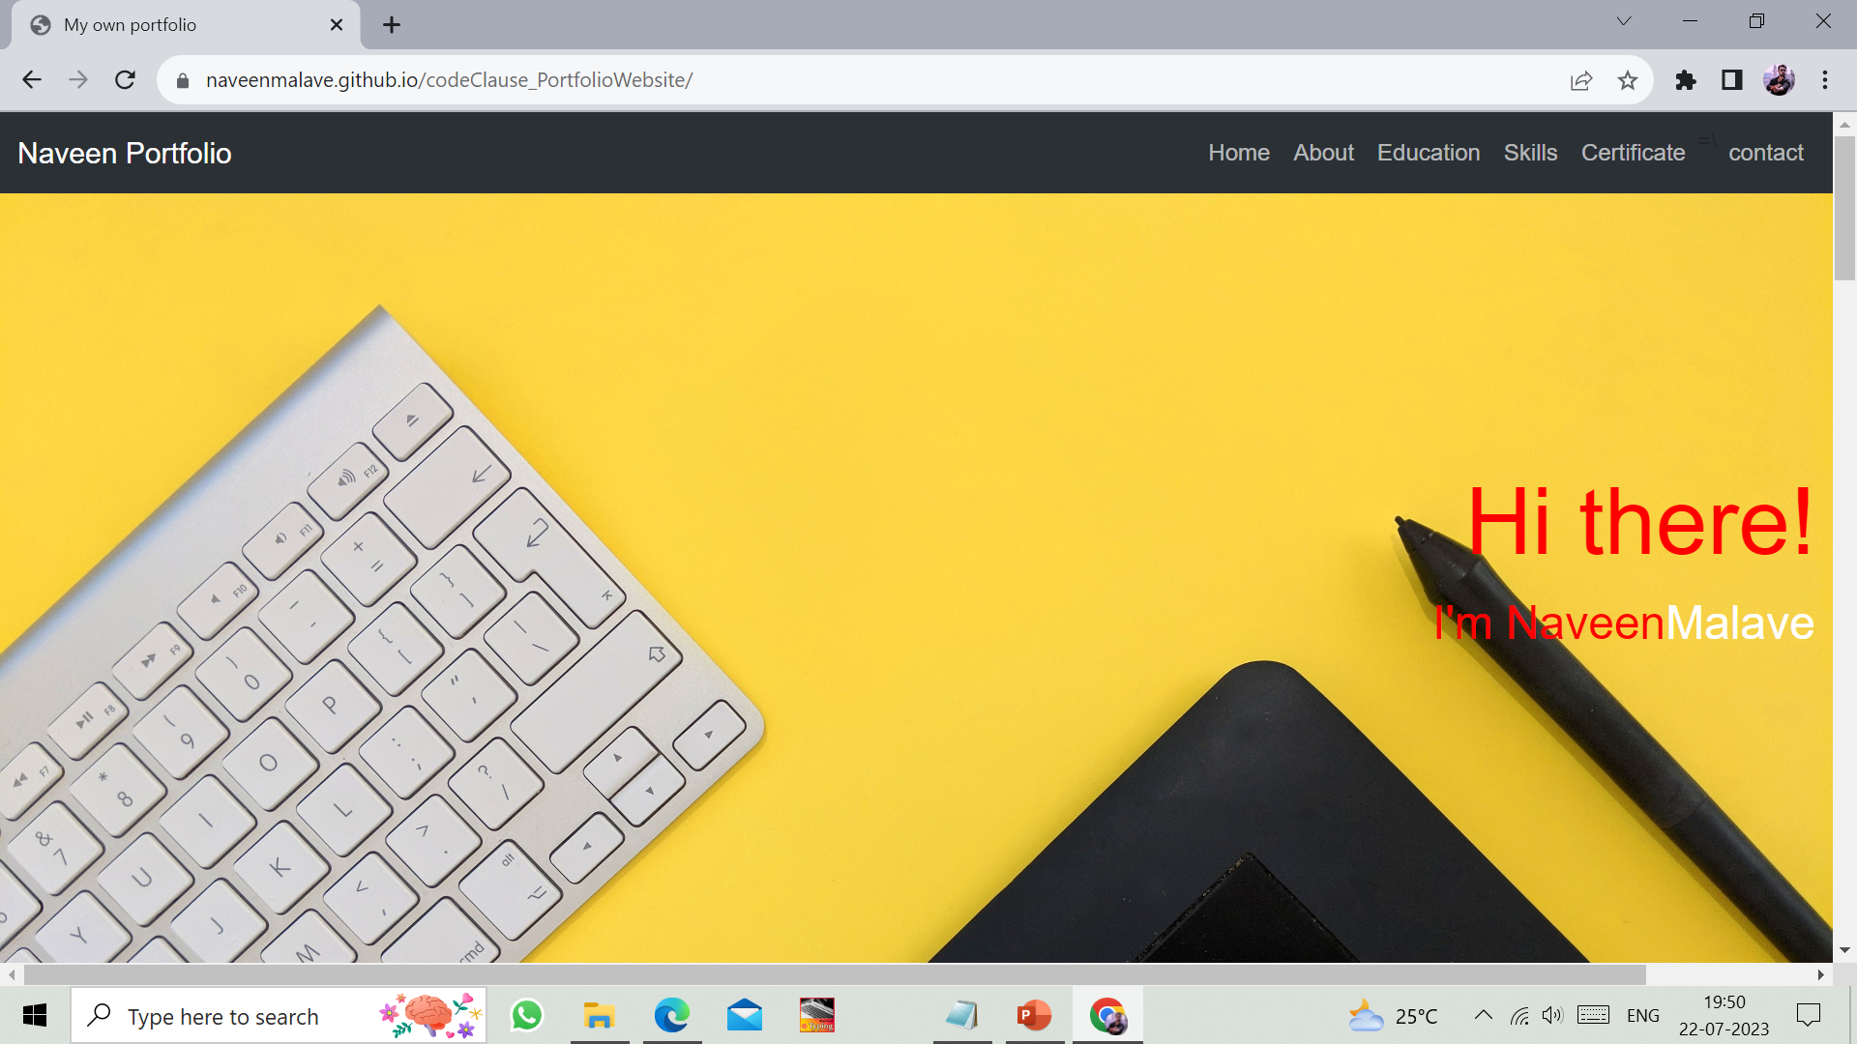
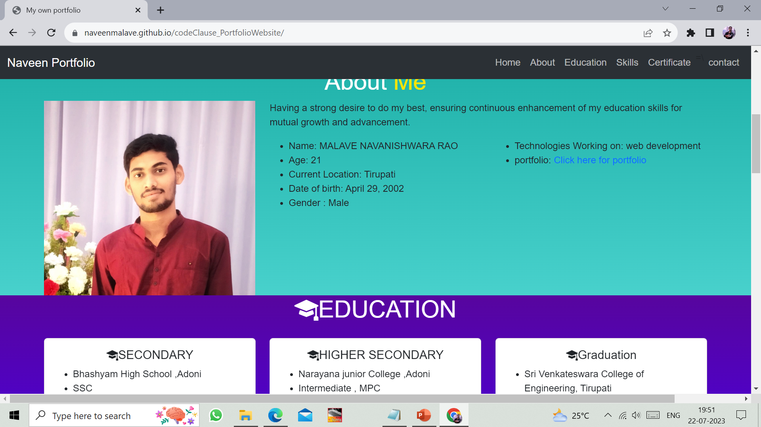

Slide 14
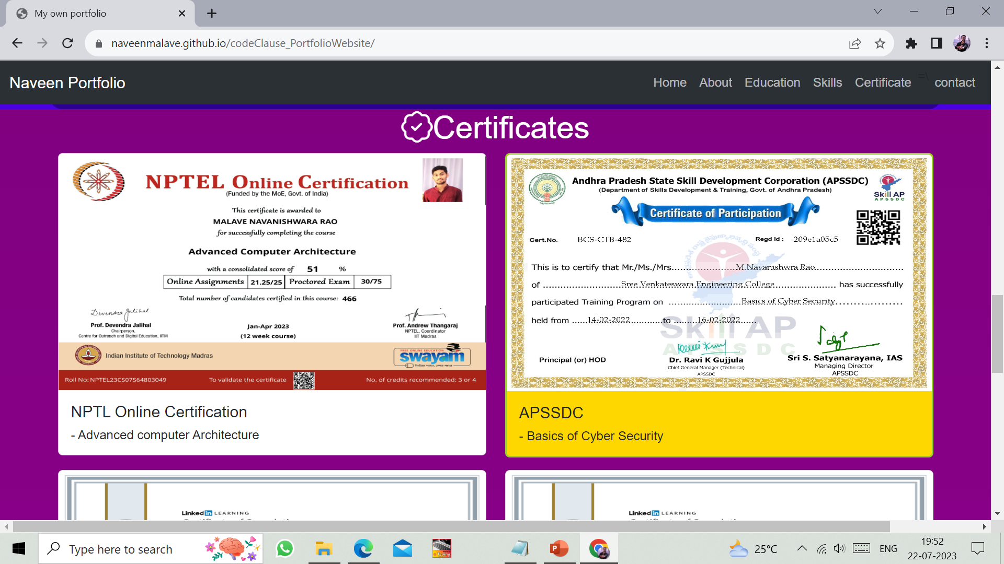
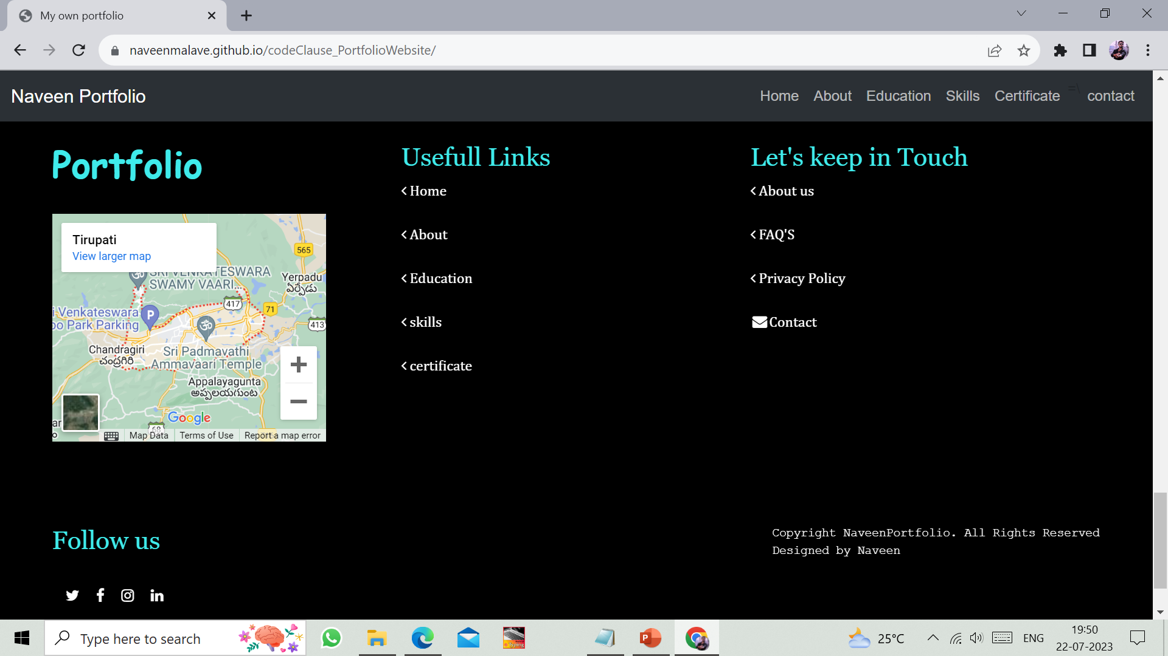

Slide 15
THANK YOU

